Slide 1
This is the Catholic Charities PowerPoint Template
Developed as of March 2023

Slide 2
There are several slide formats for the cover page
Subtitle of Presentation | Date Here

Slide 3


This is another version of the cover page
To change the format, go to the LAYOUT drop-down menu

Slide 4
This is the standard content slide
This could be a subtitle

Slide 5
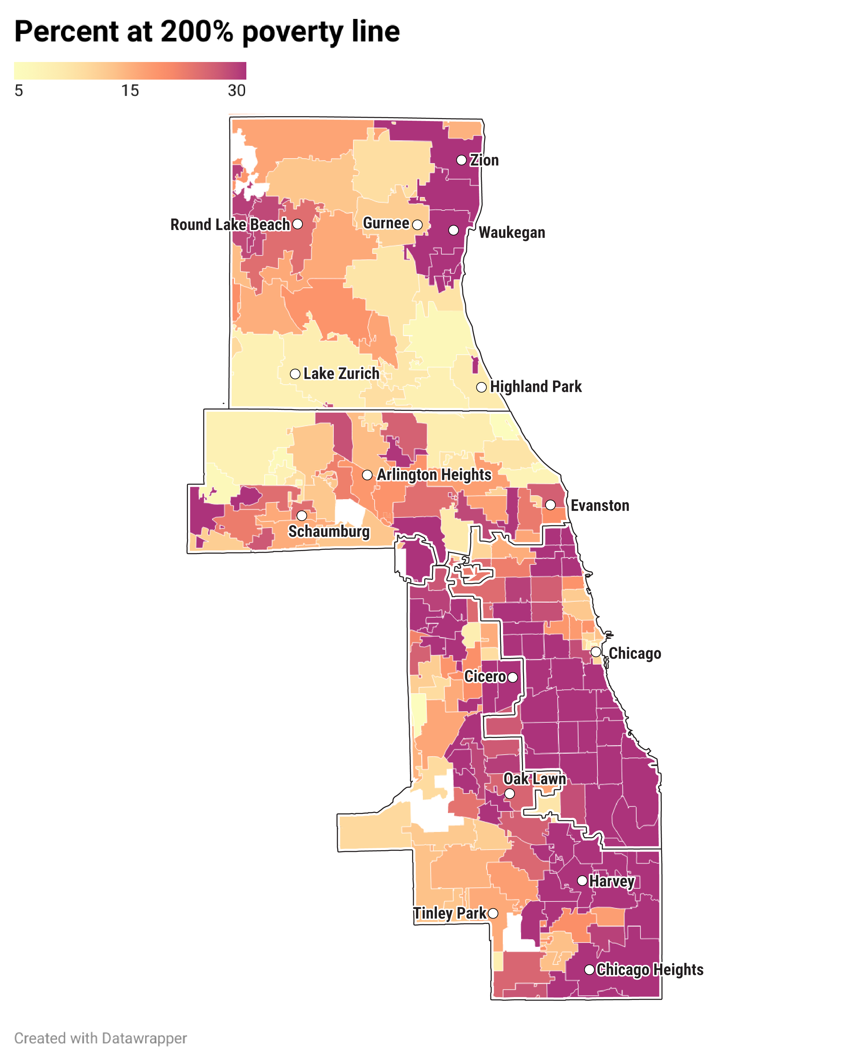
This is an example of a slide and an image

Slide 6

Here is another example of a slide and an image
And this is a subhead (18 point Arial, bold, black)

Slide 7


Here are different versions of our logo
Don’t change or amend beyond these versions

Slide 8
These are our standard colors for presentations
Only use the Catholic Charities Red very sparingly
#44546A
#E7E6E6
#0A77BB
#C4E6FC
#EFBF4E
#8C579C
#24AF89
#BCDDD0

Slide 9
We use Arial font
Format in Bold only when necessary
If another font is needed, you may use Georgia
“I am a quote that I want to stand out from the rest of the text.”
This is the attribution.

